Slide 1
NC Connect
Toolkit Guide
Resources to Share With Your Students, Networks & Communities

Slide 2

How to Use this Guide
This guide is an overview of branded materials to help your school or organization promote NC College Connect. This includes an itemized list of materials as well as recommendations for use.
We encourage downloading the toolkit materials and familiarizing yourself with the items covered in this guide.
How to access the NC Collect Connect Toolkit:
The toolkit can be accessed through the NC College Connect resources page for education professionals.
Please use the downloaded toolkit items when printing, posting on social media, etc. There is no need to screenshot the images within this PDF.

Slide 3

Printed
One-Pager
01.

Slide 4
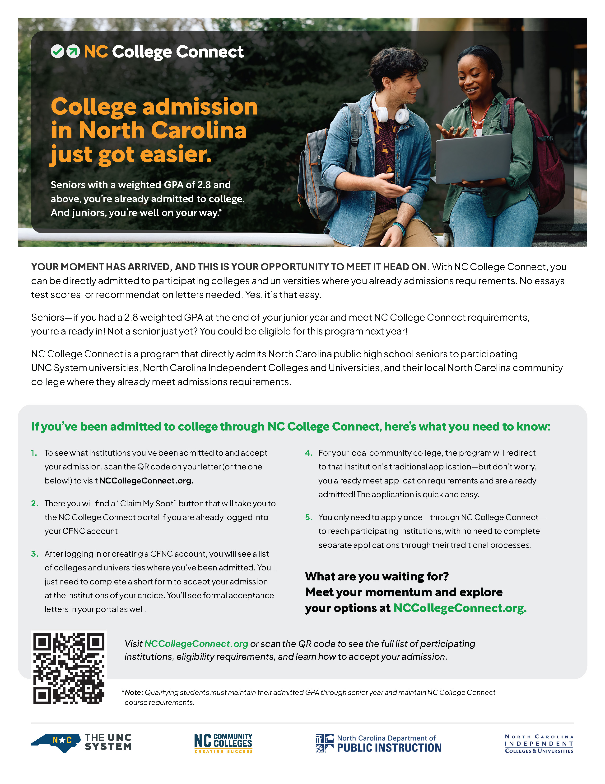
How to Use: One-Pager
The following NC College Connect one-pager has been developed to provide another way to amplify NC College Connect with students at your school or college and in your communities.
This one-pager is sized to print on 8.5x11” paper. Print this to share at events and with those in your network. It is not designed for sharing on social media and should not be used in that medium.
This one-pager is also included in the downloadable file on the NC College Connect resources page for education professionals.

Slide 5

Social Media
Graphics
02.

Slide 6
How to Use: Social Media Graphics
The social media resources in the following slides have been developed to provide optional content to elevate NC College Connect. Each social post incorporates NC College Connect branding and key messaging.
The social graphics are suitable to be shared on your Instagram, X, and Facebook profiles and are intended to be paired with versions of the example posts included in the following slides.
Feel free to add language that aligns to your brand’s tone of voice or unique information that relates to this post. However, please do not change the meaning of the language about the program or alter the social graphics in any way.
Please use the hashtag #NCCollegeConnect when posting on social media.
Note: These graphics are included in the downloadable file on the NC College Connect resources page for education professionals. There is no need to screenshot the graphics included in this document.

Slide 7

Post #1: English
X (Twitter) Copy
🚨NC students, the hard part is over! With #NCCollegeConnect you’re directly admitted to institutions where you already meet admission requirements. No test scores or essays, you’re in! All you need to do is complete a simple form and accept at: NCCollegeConnect.org!
Facebook/Instagram Copy:
🚨Students, the hard part is over! Public high school seniors with a weighted 2.8 GPA or above who meet their course requirements are eligible for direct admission at many NC colleges and universities.
With #NCCollegeConnect, you’ll be directly admitted to colleges and universities where you already meet admission requirements, no essays or test scores needed!
All eligible students need to do is:
✅ Tell institutions you accept your admission with a simple form
✅ Maintain your GPA of 2.8 or above
✅ Meet graduation & course requirements
Get the details at NCCollegeConnect.org.

Slide 8

Post #1: English
X (Twitter) Copy
Heard of #NCCollegeConnect? The program provides direct admission to many NC institutions. You’re admitted if you:
✅ are a NC public high school senior
✅ have a weighted GPA of 2.8 or above
✅ meet course requirements
See where you're admitted and confirm your spot at NCCollegeConnect.org!
Facebook/Instagram Copy:
🚨 NC high school seniors: applying to college just got easier with North Carolina’s direct admission program #NCCollegeConnect!
Eligibility is simple. You’re already admitted if you...
✅ are an NC public high school senior
✅ have a weighted GPA of 2.8 or above
✅ meet graduation & course requirements
No essays, no recommendation letters, no wait...just a few clicks. Ready to take the next step? Meet your moment at NCCollegeConnect.org!

Slide 9

PowerPoint Slides
03.

Slide 10

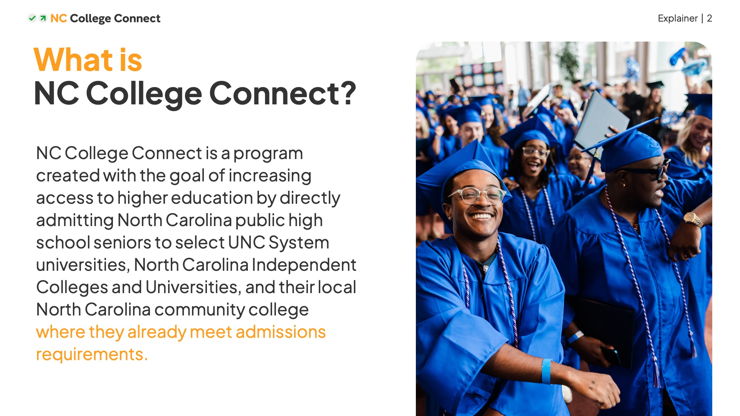
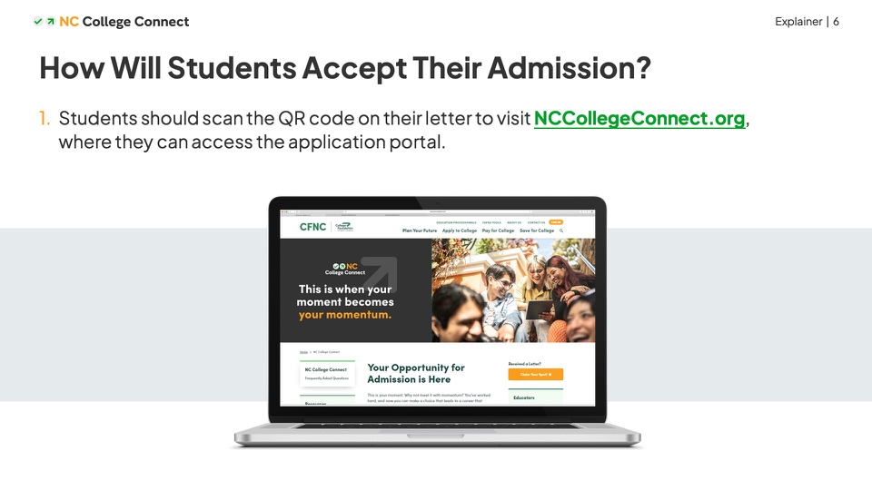
How to Use: PowerPoint Slides
The PowerPoint slides included in the toolkit are a resource to add into existing presentations about the college admissions process.
The slides include an overview of NC College Connect, how students will claim their spot, and what students should keep in mind while navigating the simplified application process.
These slides are being updated to reflect the most recent student portal experience. Check back soon for the updated version!

Slide 11

Email
Newsletter
04.

Slide 12
How to Use: Email Newsletter
Include the language below in any internal or external newsletters to spread the word about NC College Connect. All you have to do is copy and paste—be sure to choose the blurb that is best suited for your audience! This text is also included in the downloadable file on the NC College Connect resources page for education professionals.
Student-Facing Version
*Note – this was written with all students in mind, not just those eligible for NC College Connect.
Good news! If you’re a high school senior with a weighted GPA of 2.8 or above who meets minimum course requirements — you are already admitted to college, with NC College Connect, no essays or test scores needed! Not a senior just yet? You could be eligible for this program next year!
NC College Connect directly admits North Carolina public high school seniors with participating UNC System universities, North Carolina independent colleges and universities, and their local North Carolina community college where they already meet admissions requirements. It’s that simple.
How does it work? If you’re eligible, you’ll be notified by the start of the school year with an official letter and directed to the NC College Connect application portal. From there, you will see a complete list of colleges and universities where you’re already admitted and have the option to complete a simple form to accept your admission at the institutions of your choice.
Eligible students: Participating North Carolina colleges and universities are holding spots just for you — a simple, streamlined process that gets you where you want to be. This is your moment, so meet it! Learn more about the process, eligibility requirements, and see the full list of participating schools, at NCCollegeConnect.org.
Don’t think you’re eligible for this program? Don’t worry! There’s plenty of time to plan for and apply to college. CFNC.org offers numerous resources to explore college and financial aid options.

Slide 13
How to Use: Email Newsletter
Include the language below in any internal or external newsletters to spread the word about NC College Connect. All you have to do is copy and paste—be sure to choose the blurb that is best suited for your audience! This text is also included in the downloadable file on the NC College Connect resources page for education professionals.
General Version
Have a high school senior in your life? If they’re attending a public high school with a weighted GPA of 2.8 or above and meet their necessary course requirements, then they are already admitted to institutions through NC College Connect — no essays or test scores needed!
NC College Connect directly admits North Carolina public high school seniors with participating UNC System universities, North Carolina independent colleges and universities, and their local North Carolina community college where they already meet admissions requirements. It’s that simple.
How does it work? Eligible students will be notified by the start of the school year with an official letter and directed to visit the NC College Connect portal. From there, students will see a complete list of colleges and universities where they’re already admitted and have the option to complete a simple form to accept their admission at the institutions of their choice.
Colleges and universities are directly admitting students with a simple, streamlined process that gets students where they want to be. Learn more about the process, eligibility requirements, and see the full list of participating schools, at NCCollegeConnect.org.
If a student doesn’t meet admission requirements for this program, don’t worry, there are options for everyone. CFNC.org offers numerous resources to explore North Carolina colleges and financial aid options.

Slide 14

Messaging
Points & FAQs
05.

Slide 15
How to Use: Messaging Points & FAQs
Use these message points as guide for when you’re talking about NC College Connect to your communities, networks, parents, or to students—and understand the program details.
This is not meant to be printed and shared as a flyer or take-home resource for students.
This text is also included in the downloadable file on the NC College Connect resources page for education professionals.

Slide 16
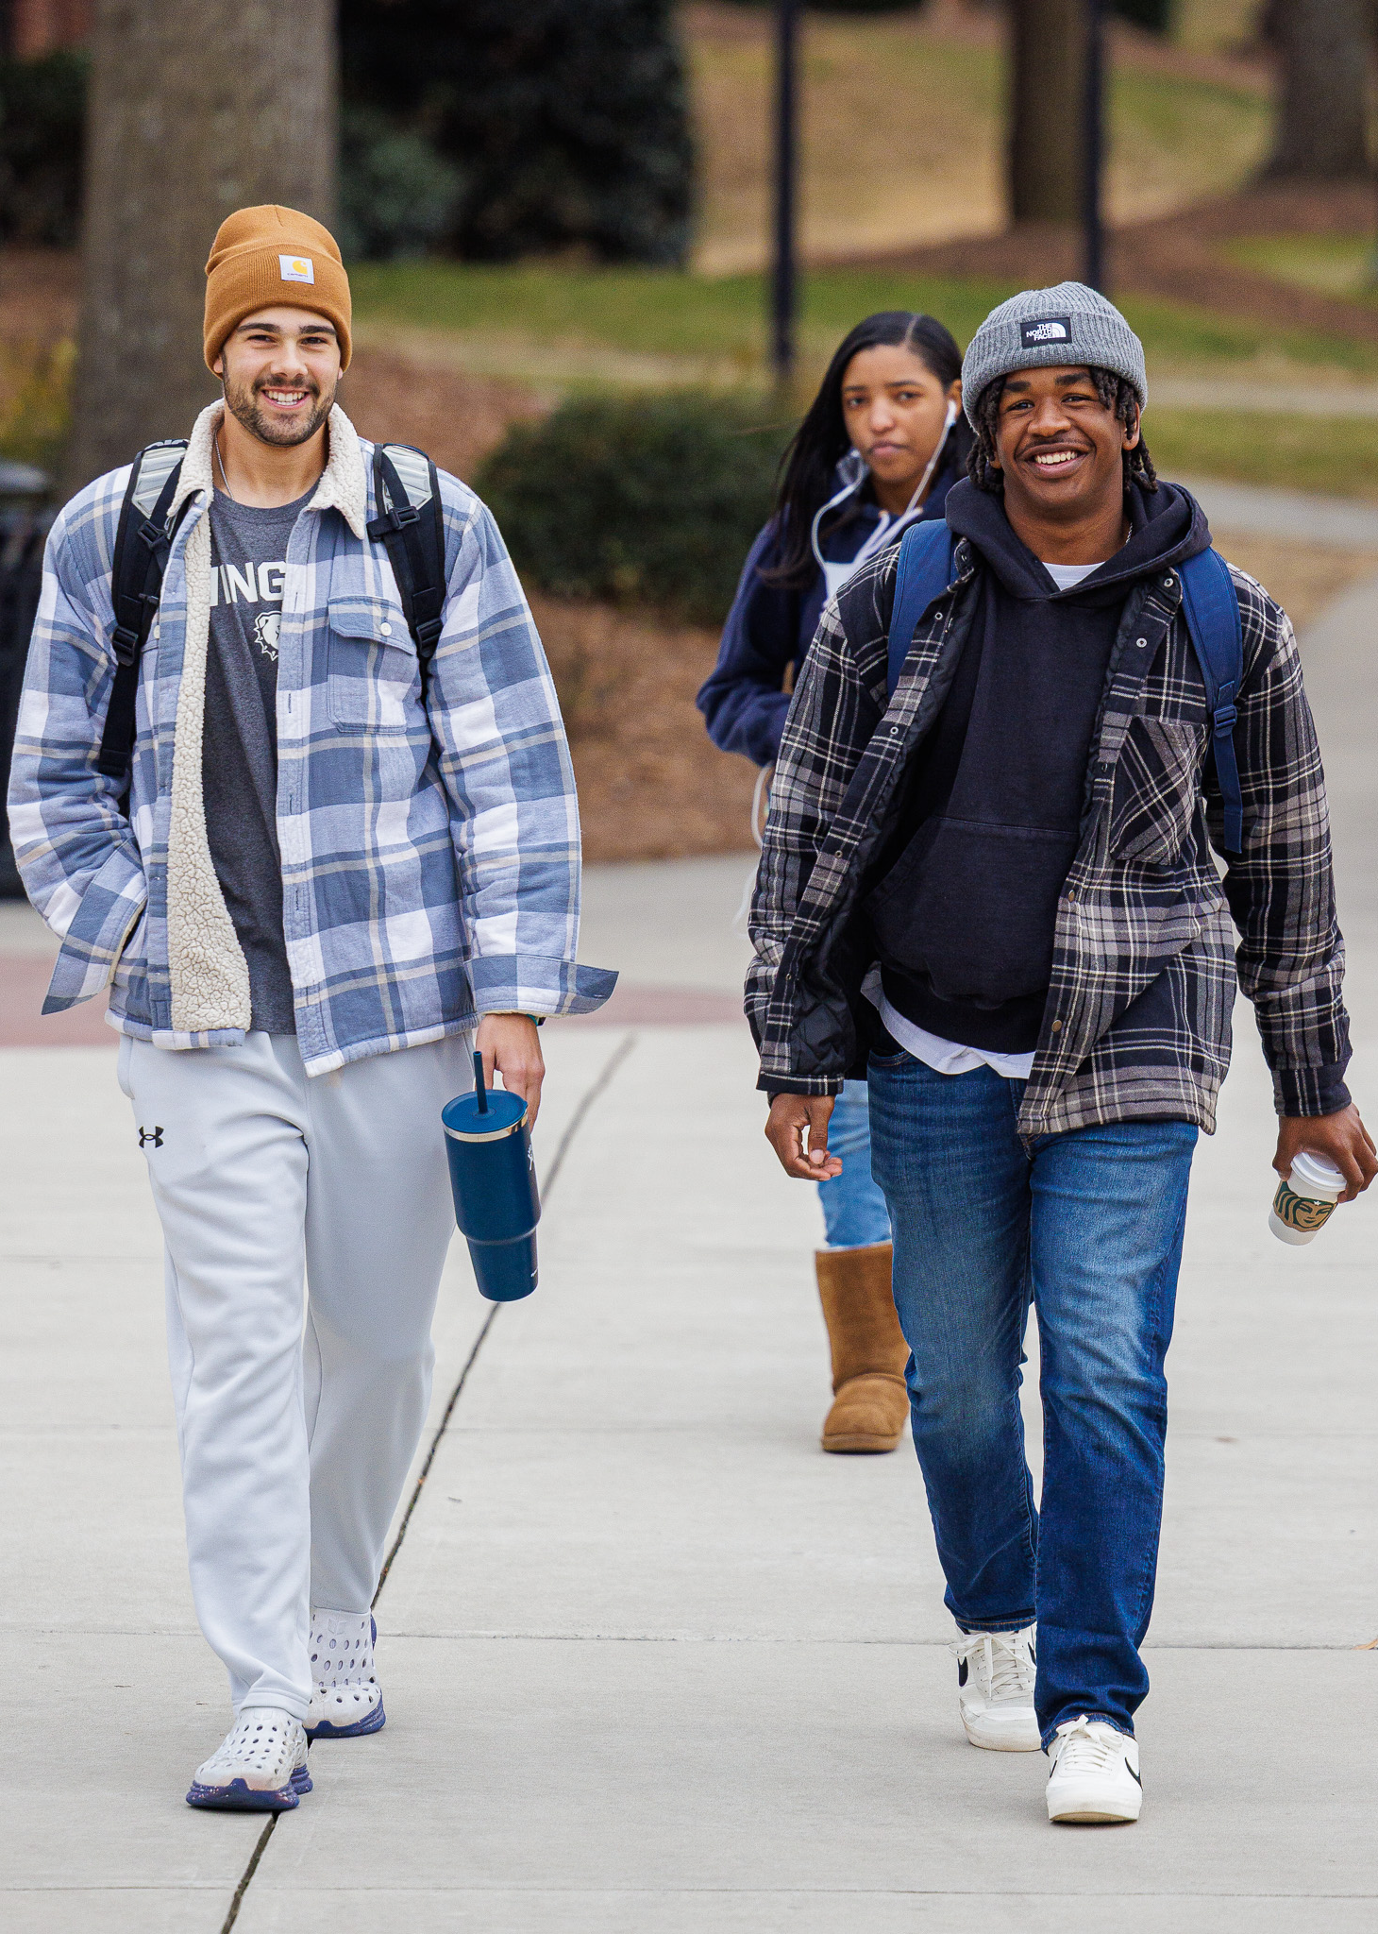
Student Flyer
06.

Slide 17
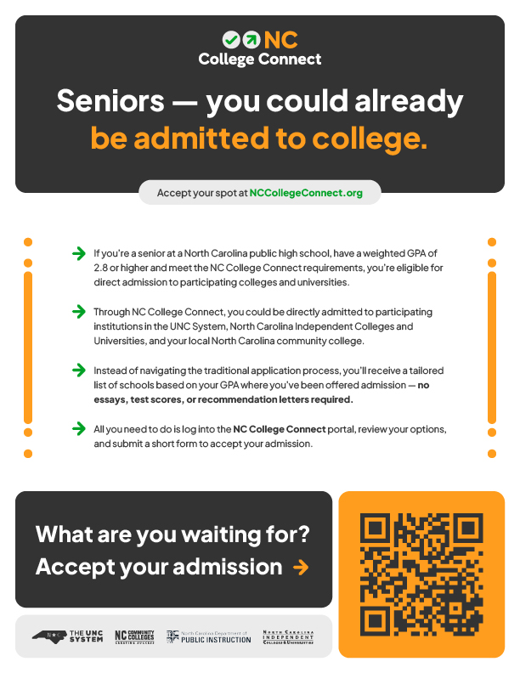
How to Use: Student Flyer
The student flyer is a high-level, action-oriented document designed to drive students to visit NCCollegeConnect.org and learn more about the program.
This flyer can be distributed digitally or physically, and is sized to print on 8.5x11” paper. Share this with students over email, or print to hang in classrooms or share at events.
This one-pager is also included in the downloadable file on the NC College Connect resources page for education professionals.

Slide 18

Parent
One-Pager
07.

Slide 19
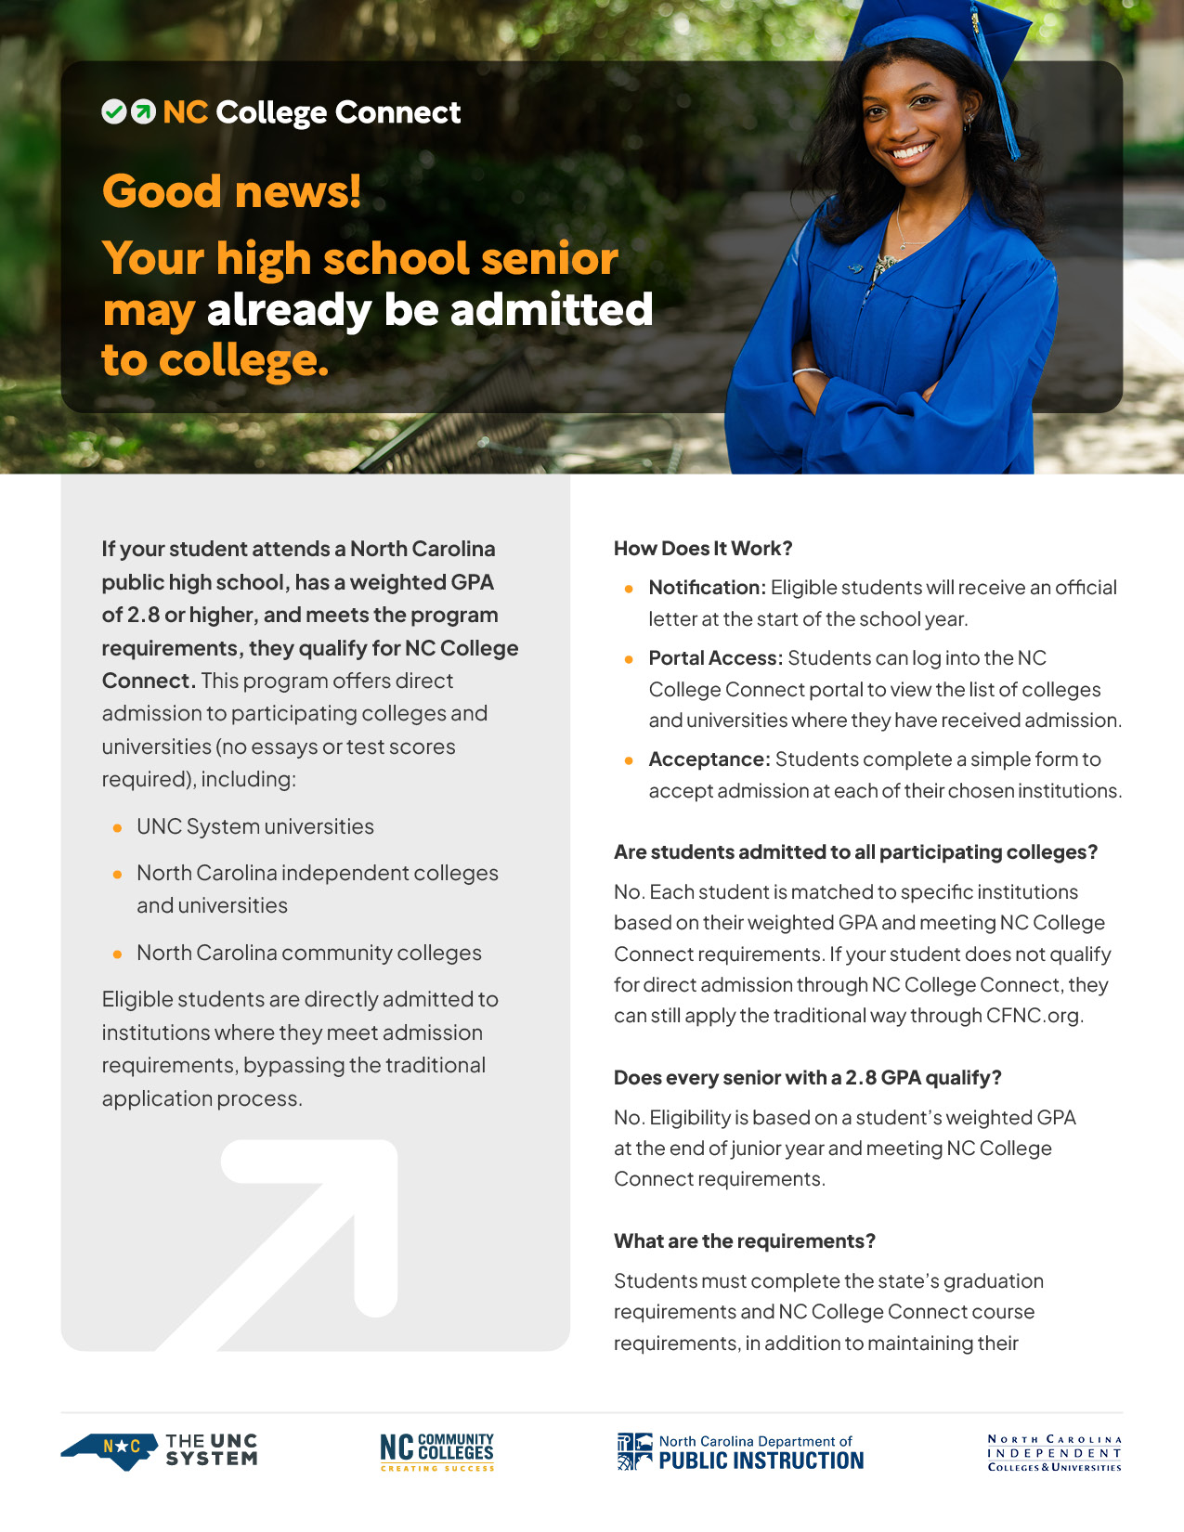
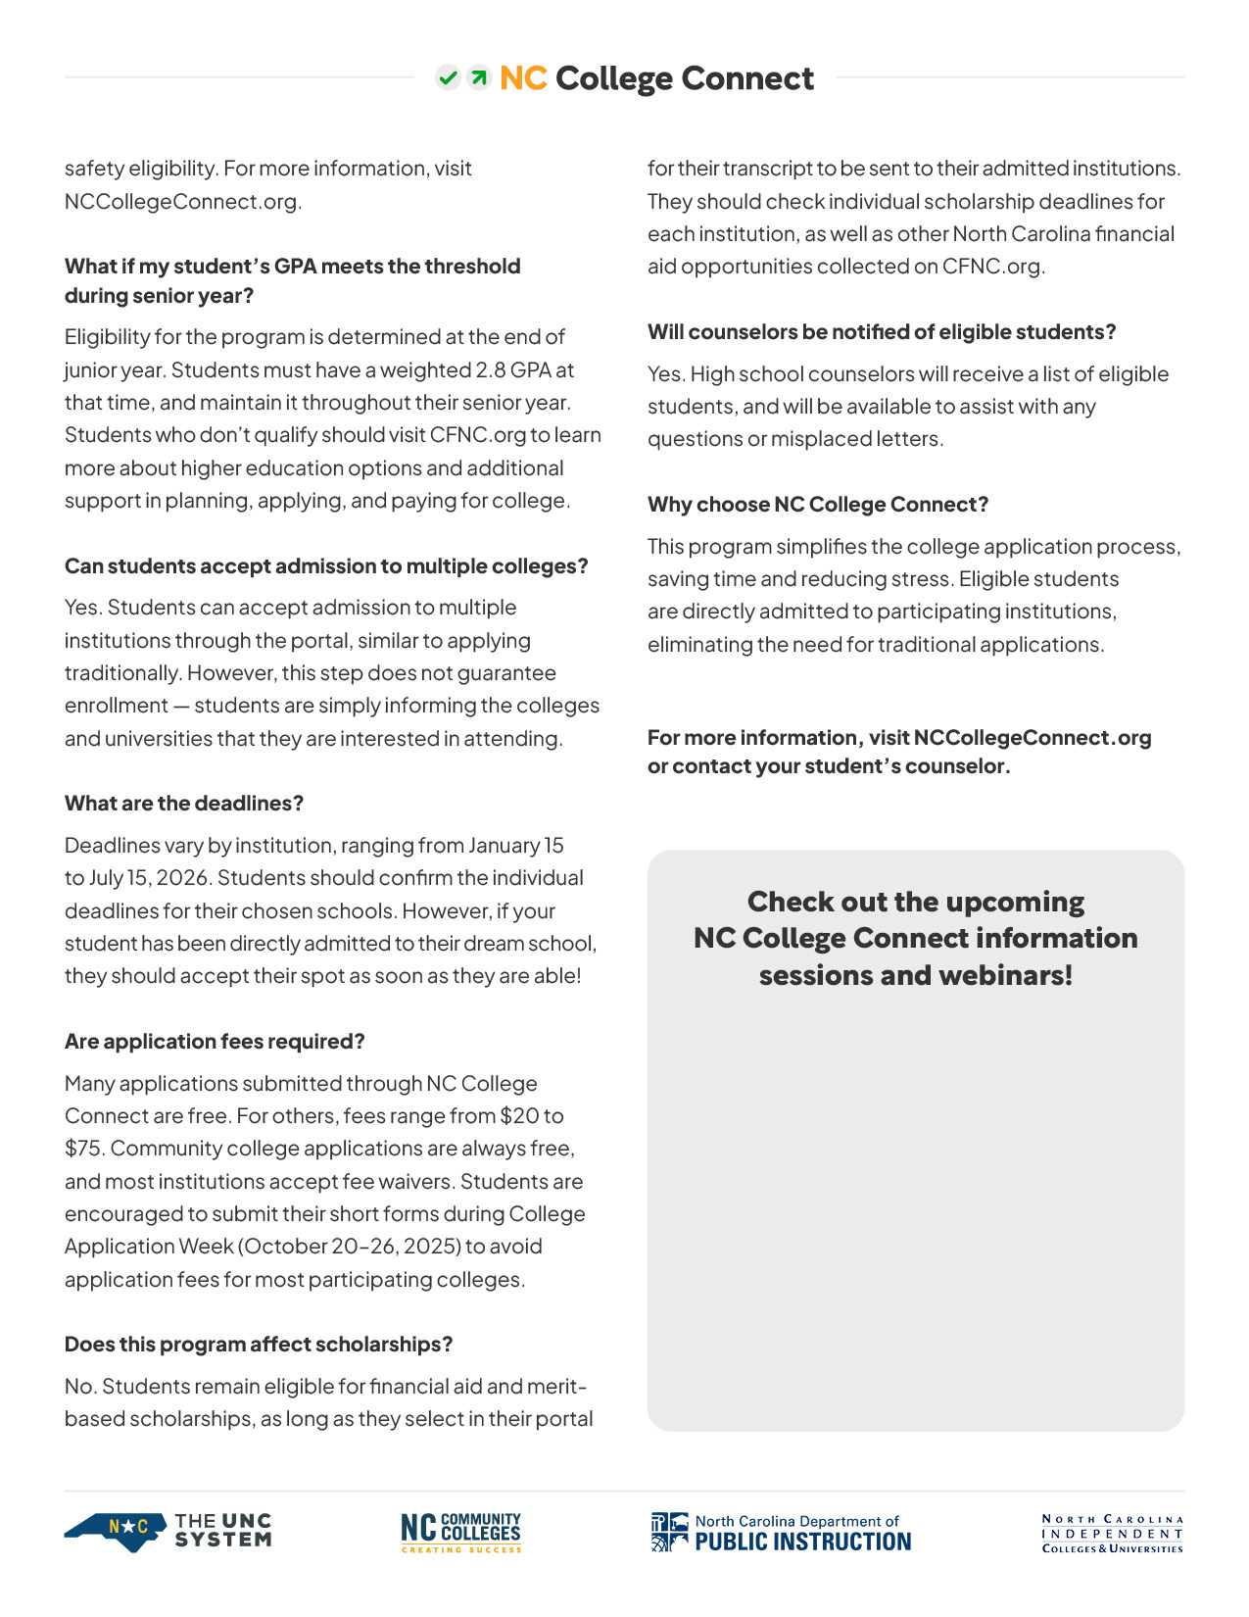
How to Use: Parent One-Pager
The following NC College Connect one-pager has been developed for parents of high school students to provide clarity and answer frequently asked questions regarding NC College Connect.
The document has a placeholder for education professionals to add details regarding information sessions and webinars for their district. For ease of editability, the document has been set up as a PowerPoint file. Once education professionals have inserted the relevant information, they may export the PowerPoint as a PDF for circulation.
This one-pager is sized to print on 8.5x11” paper. Print this to share at events and with those in your network. It is not designed for sharing on social media and should not be used in that medium.
This one-pager is also included in the downloadable file on the NC College Connect resources page for education professionals.

Slide 20
Anthem Video
08.

Slide 21

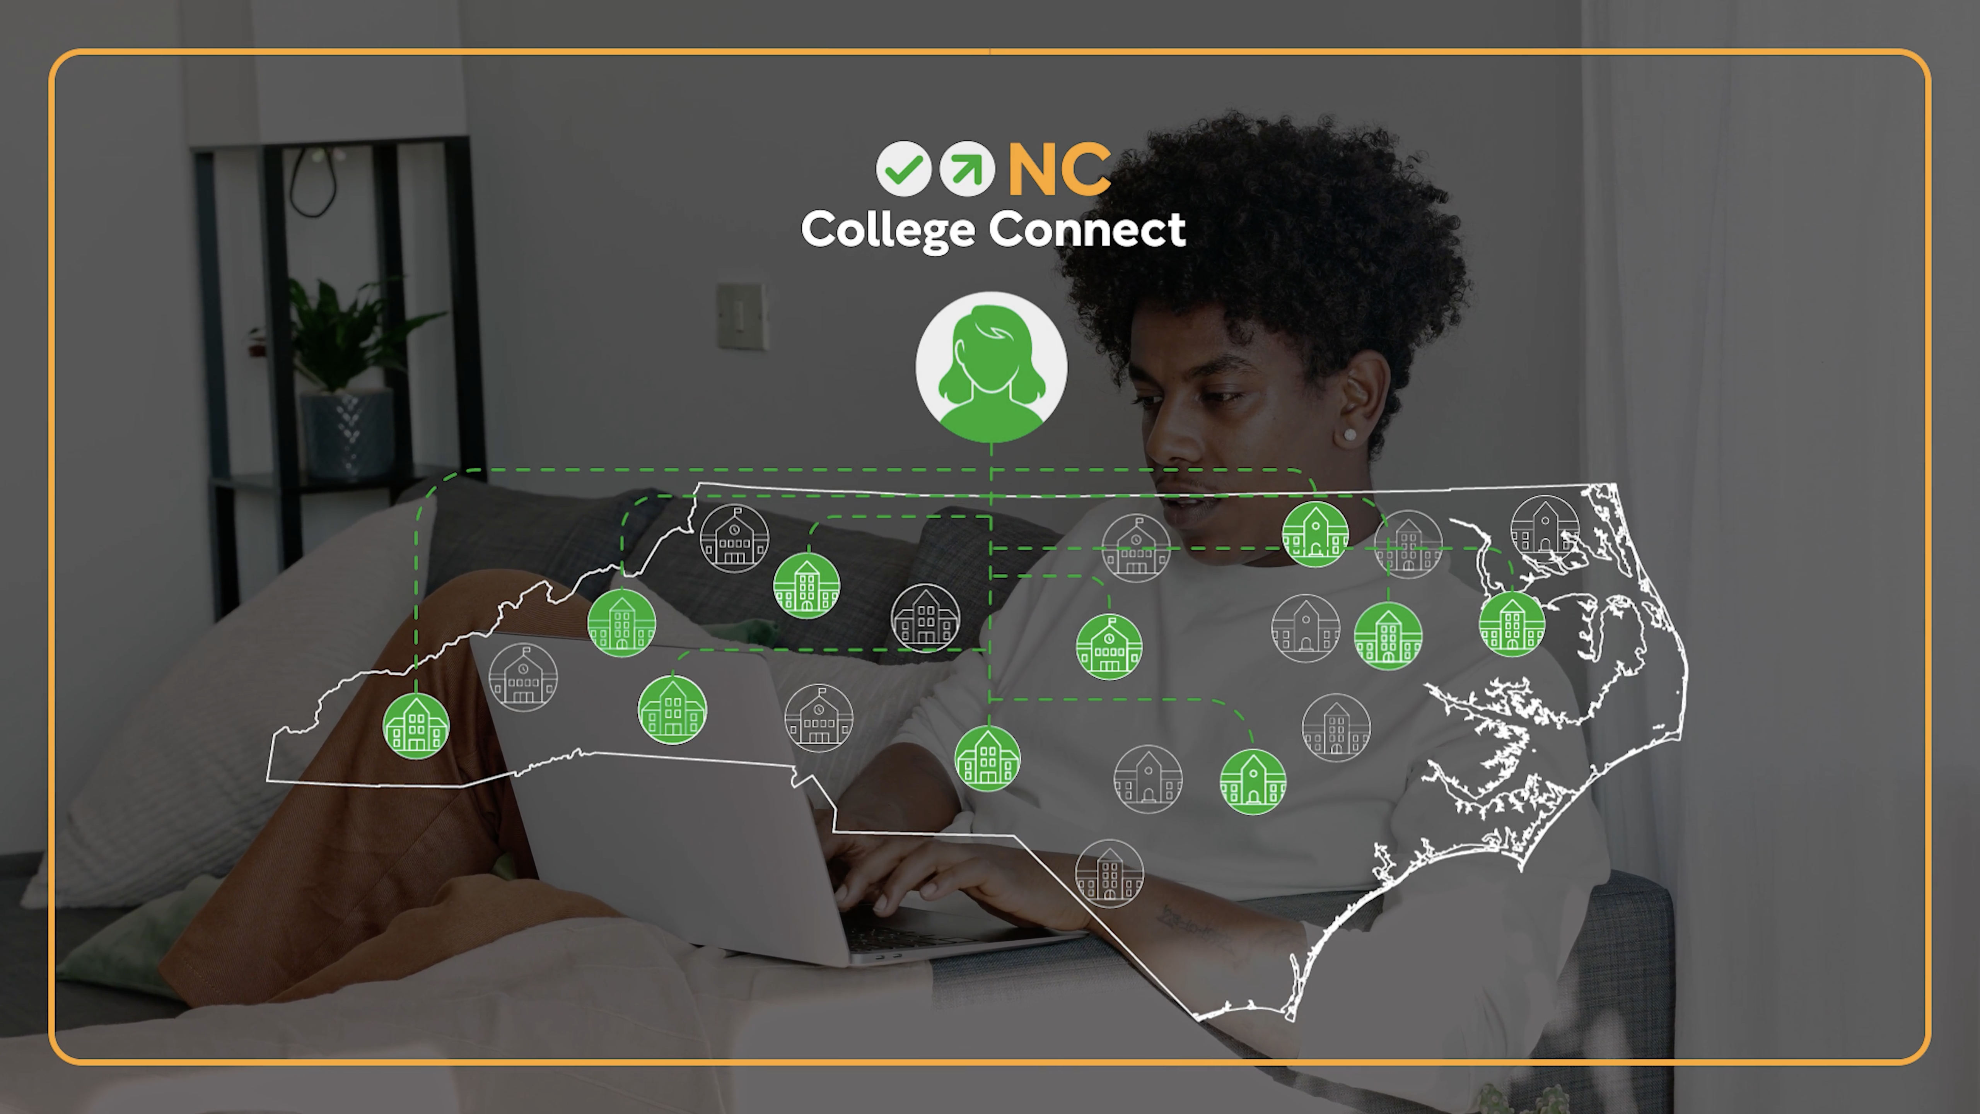
How to Use: Anthem Video
A 60-second video has been developed for introducing and explaining NC College Connect. It contains an overview of the program and its requirements and directs viewers to the website to learn more.
The video is suited to display on school television screens or shared on social media platforms such as Facebook and X.
The video is sized at a 16:9 (standard horizontal) aspect ratio.

Slide 22



Thank you!

